Slide 1
Total Cost of Ownership example case study
short presentation about two different architectures

Slide 2
Description of the environment
Let's assume that an x86 core can perform 15 TPS (Transactions Per Second)
Every CC transaction must be approved by checking:
the CC is valid
the POS is valid
the money amount is valid (for single transaction and for other limits such as monthly or daily limits)
Check if the POS type requires a second identification step to run
Check complete successfully, issue OK or abort storing the attempt.

Slide 3
Nonfunctional requirements
The average number of transactions per second (TPS) is 2.000. 90% of the time the peak is below double of the average. The maximum peak that the system must handle is the double of the 90% peak.
The system must ensure a HA at 99.999%.
In case of a disaster, such as Earthquake or flooding in the Data Center site area, the system functionality must be restored and be able to provide Production and Non-Production capabilities and at least 50% of the Dev and Test Capabilities.
The Development team has available an environment that is half the size of the full Production environment.
Before putting in production any new release of software a complete round of functional test must be completed. The Test environment is the same size of the development environment.
Before putting in production any new release of software a complete round of performance test must be completed stressing the system at TPS peaks.
The Software is written in Java and run on the selected Application Server (See Assignment request).
The DB used by the system is the selected DB (See Assignment request).

Slide 4
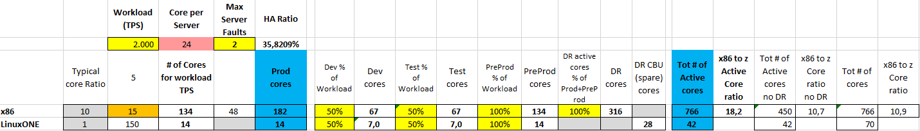
sizing
The input provided is that the systems must support up to 2000 TPS
Our input is that a x86 core can process 15 TPS
Based on literature and what said previously, a LinuxONE core (aka IFL) can perform 10x TPS, therefore 200 TPS
There are two more servers to increase availability

Slide 5
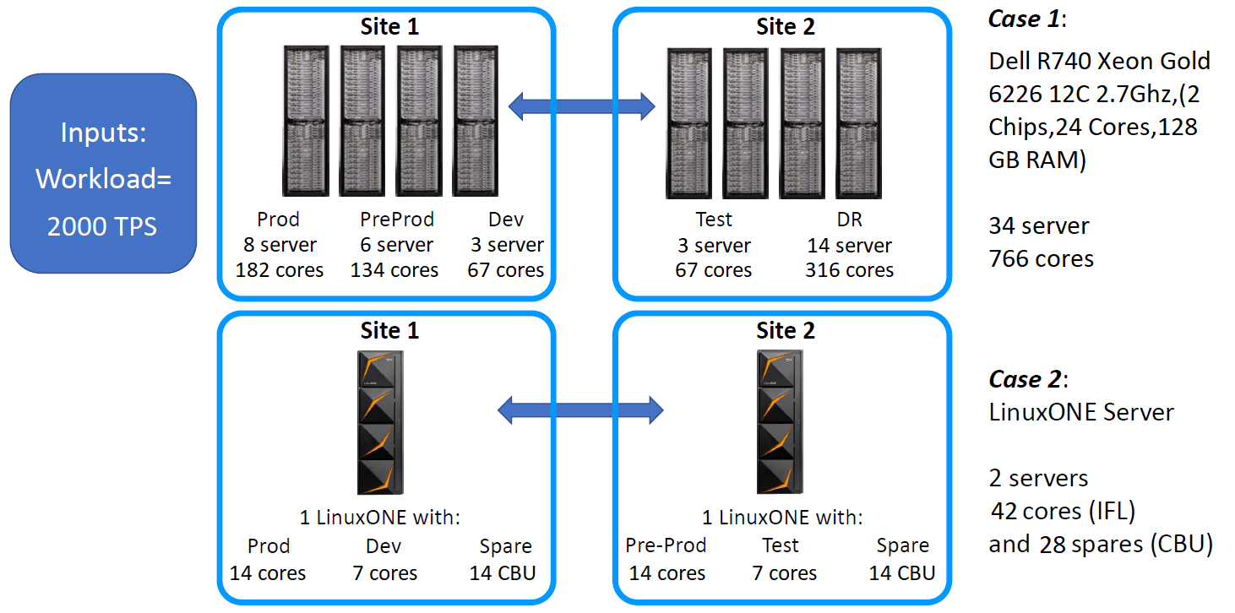
Technical Architectures for the two cases

Slide 6
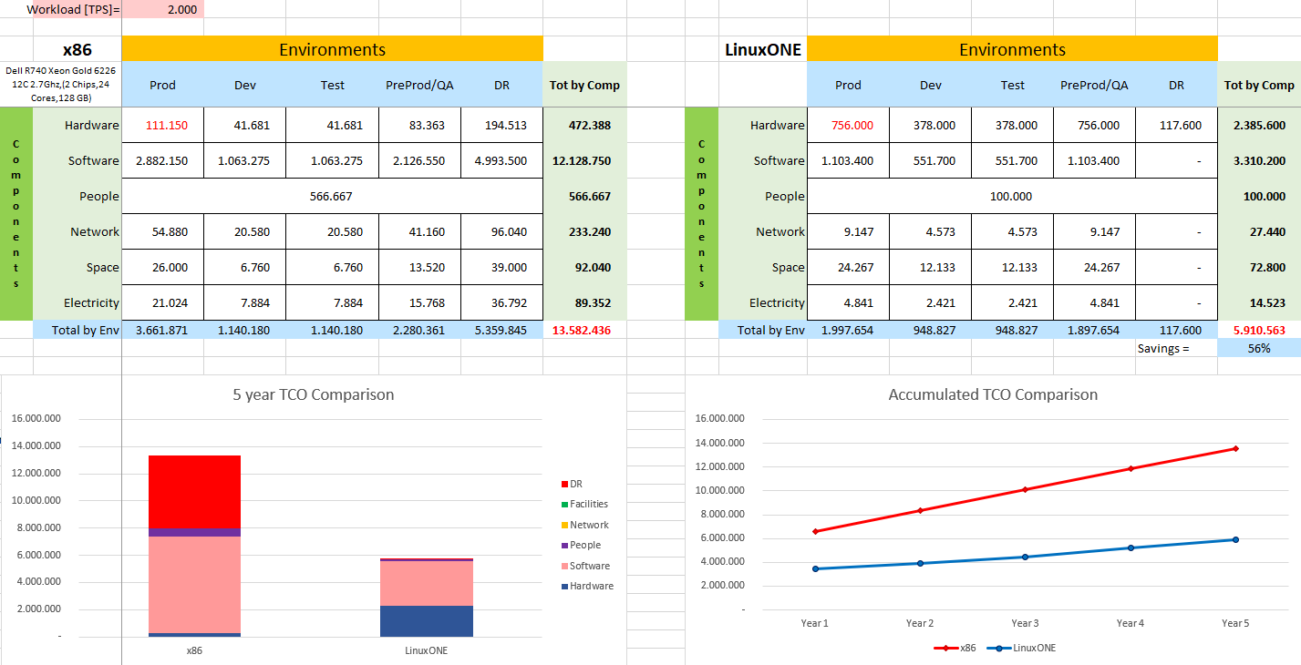

TCO Comparison on 5 years

Slide 7
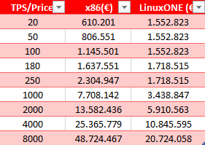
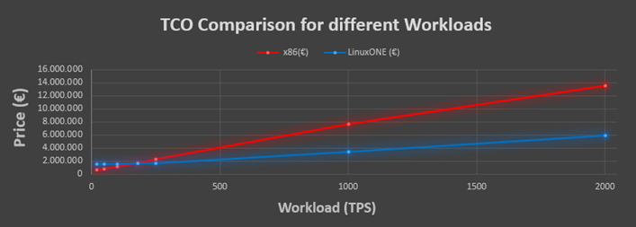
TCO Comparison for different workloads
Evident convenience of the LinuxONE architecture compared to the x86
for Workloads over 180 TPS

Slide 8
x86 TCO Assumptions
Hardware
Dell R740 Xeon Gold 6226 12C 2.7Ghz (2 Chips, 24 Cores, 128 GB RAM)
Acquisition cost: 11’875 € - 35% discount including 2 years warranty
Support cost is 20% of purchase price
Network
7000 € per Server -30% discount maintenance 10% of purchase price from year 2
People
One Full-Time Equivalent covers 30 server
Average yearly fully loaded cost: 100’000 €
Space
Fully loaded cost per square meter: 2600 € (about 100’000€ in 5 years)
Electricity
Cost per KWh: 0,10€
Software
OS: subscription 2000€/year per socket -20% discount
VM: license 5000€/socket -20% discount maintenance 20% of license per year from year 2
Application Server: license 100€/PVU (Processor Value Unit of IBM) -75% discount (70 PVU per Core) maintenance 20% of license per year from year 2
DB: license 40’000€ for 2 cores -75% discount maintenance 20% of license per year from year 2
Data Replication Tools: subscription 3000€/year -75% discount
Monitoring Tools: license 5000€/server -40% discount maintenance 20% of license per year from year 2
Security Tools: license 5000€/server -40% discount maintenance 20% of license per year from year 2

Slide 9
LinuxONE TCO Assumptions
Hardware
LinuxONE servers
Acquisition cost: 1’420’000 €/site- 30% discount including 3 years support
Maintenance cost: 10% of purchase price from year 4
Network
14000 € per Server -30% discount maintenance 10% of purchase price from year 2
People
One Full-Time Equivalent covers 10 server
Average yearly fully loaded cost: 120’000 €
Space
Fully loaded cost per square meter: 2800 € (about 70’000€ in 5 years)
Electricity
Cost per KWh: 0,10€
Software
OS: subscription 6000€/year per socket -20% discount
VM: included in the Hardware
Application Server: license 100€/PVU (Processor Value Unit of IBM) -50% discount (120 PVU per Core) maintenance 20% of license per year from year 2
DB: license 40’000€ for 2 cores -50% discount maintenance 20% of license per year from year 2
Data Replication Tools: subscription 3000€/year -50% discount
Monitoring Tools: license 5000€/server -40% discount maintenance 20% of license per year from year 2
Security Tools: license 5000€/server -40% discount maintenance 20% of license per year from year 2

Slide 10
Personal Consideration
Two more servers have been introduced to ensure very High Availability on x86 architecture
In case of disaster both architectures guarantee 100% production, 100% Pre-Production, 50% Dev and 50% Test (as shown in slide 5)
Not all cores are used on average!
6 server in Production = 6*24 cores = 144 cores -> 2160 TPS
Therefore, the System is stable if the Workload has a maximum variation of ± 160 TPS (± 8%) from the average of 2000 TPS
90% of the peak (max. 4000 TPS) is manageable by redirecting the production load on the DRs (the CBUs for LinuxONE systems)
Pros: No additional costs
Cons: In case of disaster, it’s no more possible to manage Workload Peaks and Pre-Prod, Dev and Test at the same time.
For the x86 architecture it’s possible to redirect the Workload on the high availability servers
Pros: Additional sustainable Workload at no additional cost (+720 TPS, +1440 TPS with the use of DRs during peaks)
In case of disaster, 70% Pre-Prod, 50% dev, 50% test, 100% Prod with peaks up to 4000 TPS can be guaranteed using DRs in Production Boost.
Cons: No high availability in case of failures

Slide 11
Personal Consideration
The maximum peak (8000 TPS) is not manageable by this system alone. The possible solutions are:
Oversize The System (Assuming the choice of LinuxONE architecture)
A System which guarantees 4000 TPS, guarantees HA, Disaster Recovery and 90% of the peak (Wonderful !) or HA and 100% peaks, but costs 5kk more !
A System which guarantees 8000 TPS, guarantees everything but costs 15kk more
Redirect the excess Workload to a Cloud System
The cost is per use or per rental
Substantial short-term savings compared to system oversizing
Do not serve the rare excess Workload, drastically reducing the availability
For me, the right compromise is an oversized server for 4000 TPS at the cost of 5kk more, covering the rare 8000 TPS peaks with DRs or with a cloud system, because the probability of suffering a disaster during the rare peaks (which means a disaster during holidays, Christmas etc.) is an even more rare catastrophic eventuality. If a disaster occurs, there is probably time to fix it before a peak above 4320 TPS (5460 TPS using HA cores as Production Boost)

